Slide 1

A Two-Level Statistical Model for Big Mart Sales Prediction
Group members:-
Rudresh Lawgankar
Bilal Sayyed
Shubham Mahamunkar
Guided By:-
Prof.Sukhada Aloni

Slide 2

Problem Statement:-
The aim is to build a predictive model and find out the sales of each product at a particular store.
Using this model, BigMart will try to understand the properties of products and stores which play a key role in increasing sales.

Slide 3
Introduction
Sales is a lifeblood of each and every company and sales forecasting plays a vital role in conducting any business.
Good forecasting helps to develop and improve business strategies by increasing the knowledge.
Sales forecasting is sales prediction that is based on the available resources from the past

Slide 4
Literature review
Business data mining - A machine learning perspective
Bose, Indranil, and Radha K. Mahapatra, Information & management, Vol. 39(3), pp. 211-225, February, 2001.
2. Is Combining Classifiers with Stacking Better Than Selecting the Best One?
Deroski, Saso and Bernard Enko.”, Machine learning, Vol. 54(3), pp. 255-273, March, 2004
3. A Survey on Retail Sales Forecasting and Prediction in Fashion Markets
Beheshti-Kashi and Samaneh,Systems Science & Control Engineering, Vol. 3, pp. 154-161, December, 2014.

Slide 5
Domain of the project
Machine Learning
Data Mining

Slide 6
Keywords
Data mining.
Machine learning.
Continuous values prediction.
Stacking.
Sales Prediction.

Slide 7
Technology Stack
GOOGLE COLAB
PYTHON FLASK

Slide 8
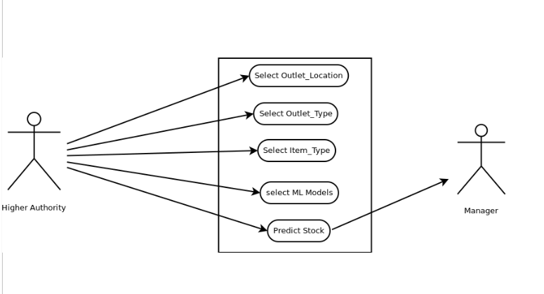
Use case diagram:-

Slide 9
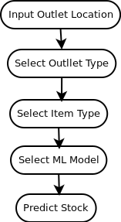
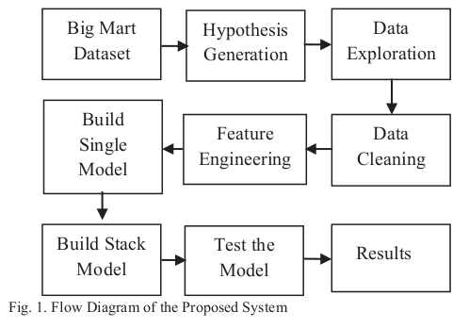
Flow of the System
Front-End
Back-End

Slide 10
Conclusion
Each and every company desires to know the demand of the customers in any season beforehand to avoid the shortage of products.
An effort has been made to predict salesof the product from a particular outlet accurately by using a two-level statistical model that reduces the mean absolute error value up to 39.17 %.
The two-level statistical model outperformed the other single model predictive techniques

